Slide 1
The University of Queensland
School of Earth and Environmental Sciences
Geophysical Imaging with Finite Elements and Python
Lutz Gross
E-mail : l.gross@uq.edu.au

Slide 2
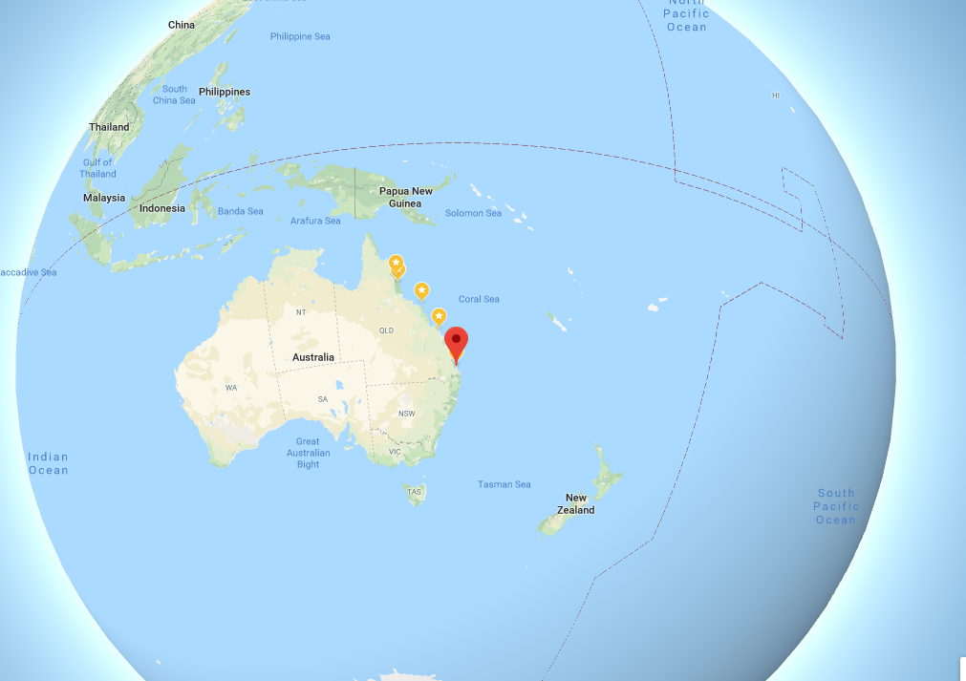


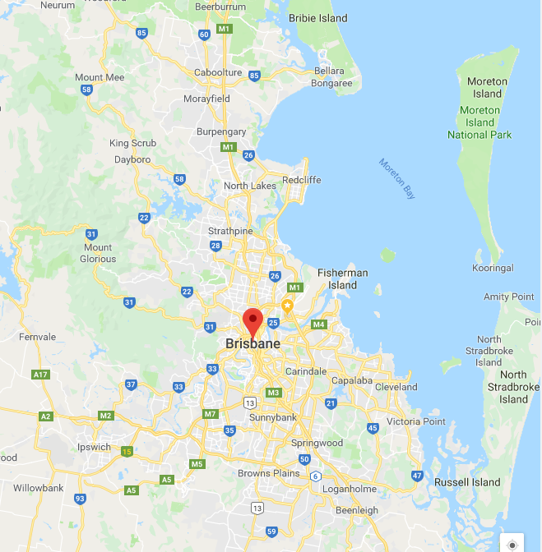

Where is Home?

Slide 3

Course Outline
AIM: Hands-on introduction to
  Python
  Finite element method and application in geophysics
  Concepts of inversion
Content:
Week 1 (3/11): Introduction to python (incl. practical with Jupyter notebooks)
Week 2 (10/11): More on python programming (incl. practical with Jupyter notebooks)
Week 3 (17/11): Introduction to the Finite Element Method (FEM)
Week 4 (24/11): FEM modeling in geophysics using esys-escript in python
Week 5 (1/12): Parameter Fitting (incl. practical with Jupyter notebooks)
Week 6 (8/12): The Concept of Inversion
Week 7 (15/2): FEM-based Inversion in Geophysics
Week 8 (22/12): Advanced Inversion Techniques

Slide 4
We use Open Source software
This is software with source code that anyone can inspect, modify, and enhance
  But watch out for the license: Apache, GPL, etc
Developments are carried by communities
  Need help: https://www.python.org/about/help/
  Get help and help others!
All documentation is on-line:
  Not happy? Fix it!

Slide 5
Software for the Course
What software do I need for the course?
  Python3
  Arrays: Numpy
  Visualization: Matplotlib
  numerical algorithms: Scipy
  FEM solver: esys-escript
Jupyter notebook
  Edit & run scripts via Web-based server
  Integrating text & code

Slide 6
Beyond Jupyter Notebook
Integrated Development Environment (IDE)
  PyCharm
  PyDev with Eclipse
  Spyder IDE
  Python IDLE
  etc

Slide 7
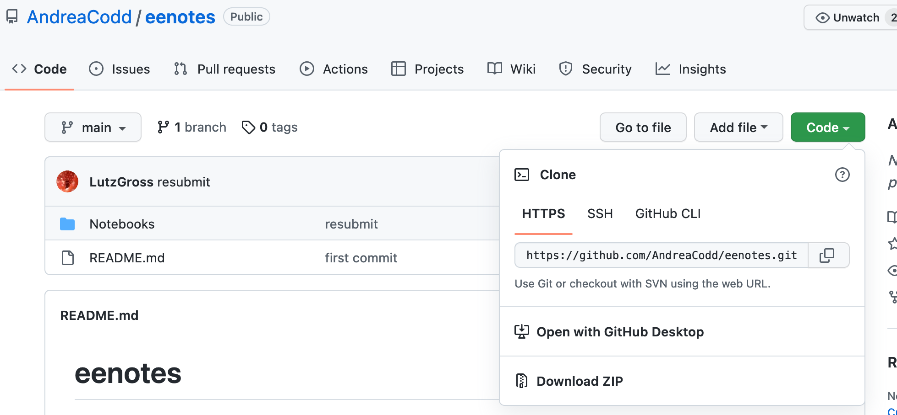
Course Material on GitHub

Slide 8
Software Access
A) Python distribution anaconda
  Install via https://www.anaconda.com/
  Includes many python modules
  Limited esys-escript support :-(
B) install a web-server
  Via a Docker virtual machine
  See notes distributed

Slide 9
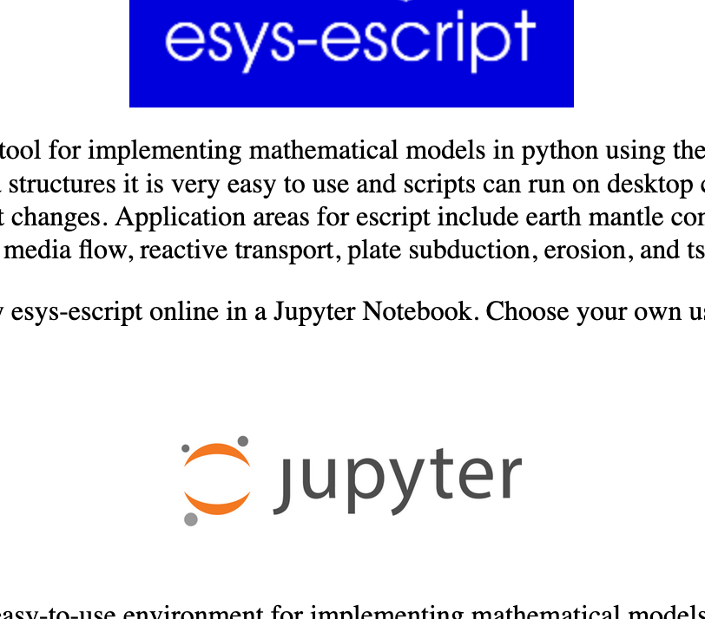
C) use cloud server
Visit https://esys-escript.github.io/
Click on Jupyter logo
Click here

Slide 10
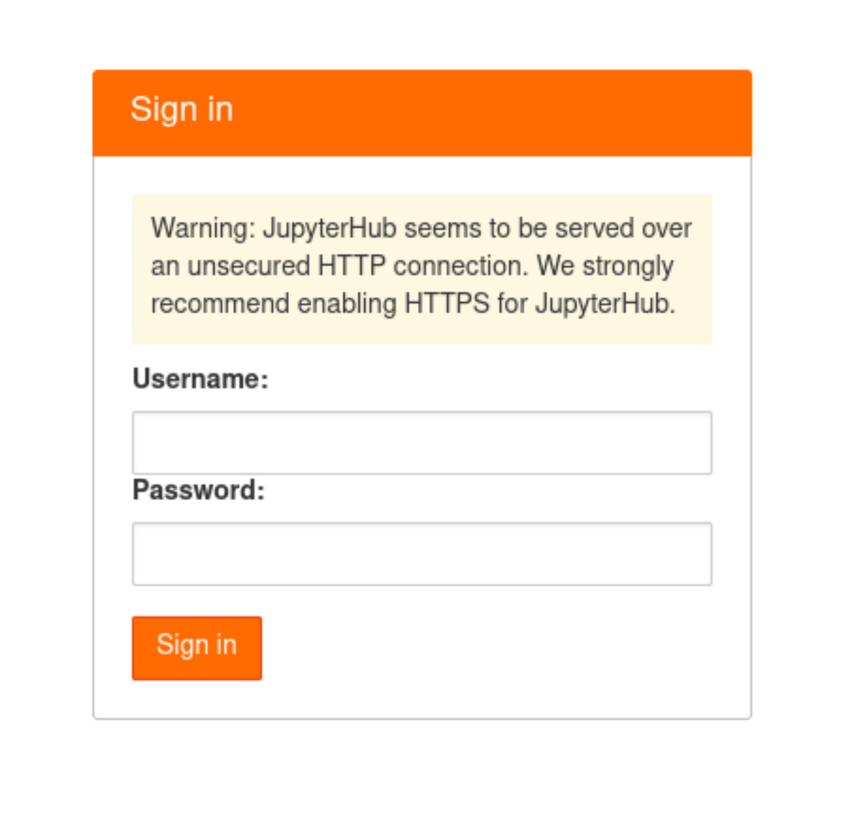
Create An Account
Don’t forget your password!
Download your data at one point ...

Slide 11
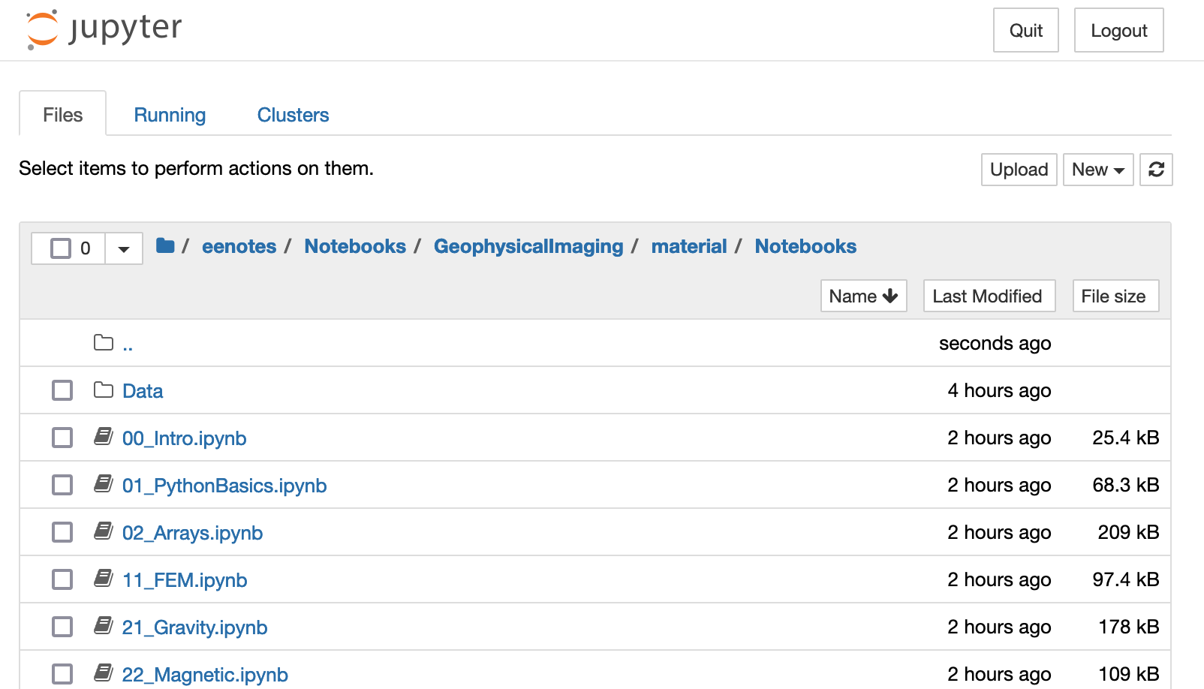
Navigate to Course Material
With preloaded course material

Slide 12
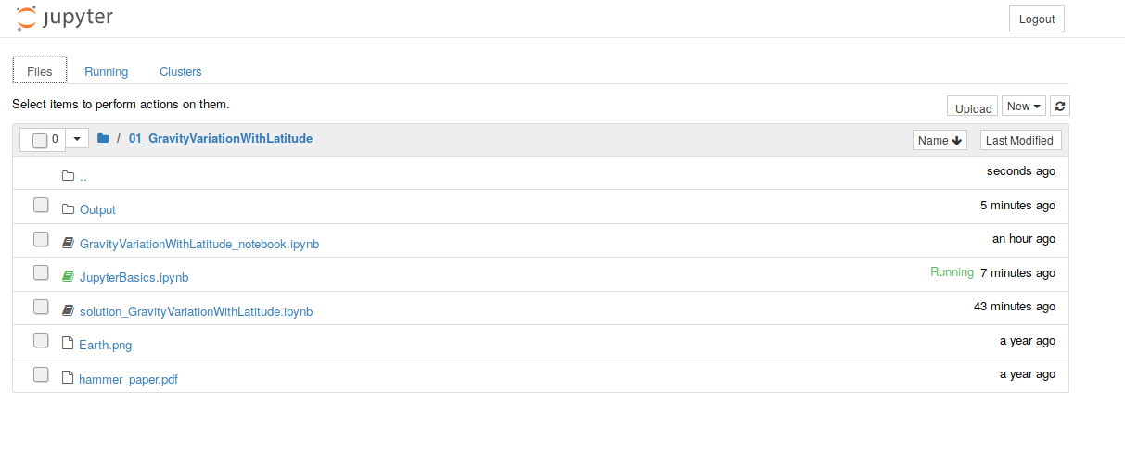
After login
Leave
Jupyter
Your files and
directories
Upload file
Create new
notebook,
directory
Notebook running
in other browser tab
Click to start
Notebook in new tab

Slide 13

Jupyter notebook
web application → use your favorite browser
  contain live python code
  includes narrative text
  contains equations
  includes visualizations
  to create and share documents
See https://jupyter.org/

Slide 14
A jupyter notebook
is two things:
  A document containing text and python code
    Extension: ipynb
  A session
    to render the text
    to run the code/sections of the code

Slide 15
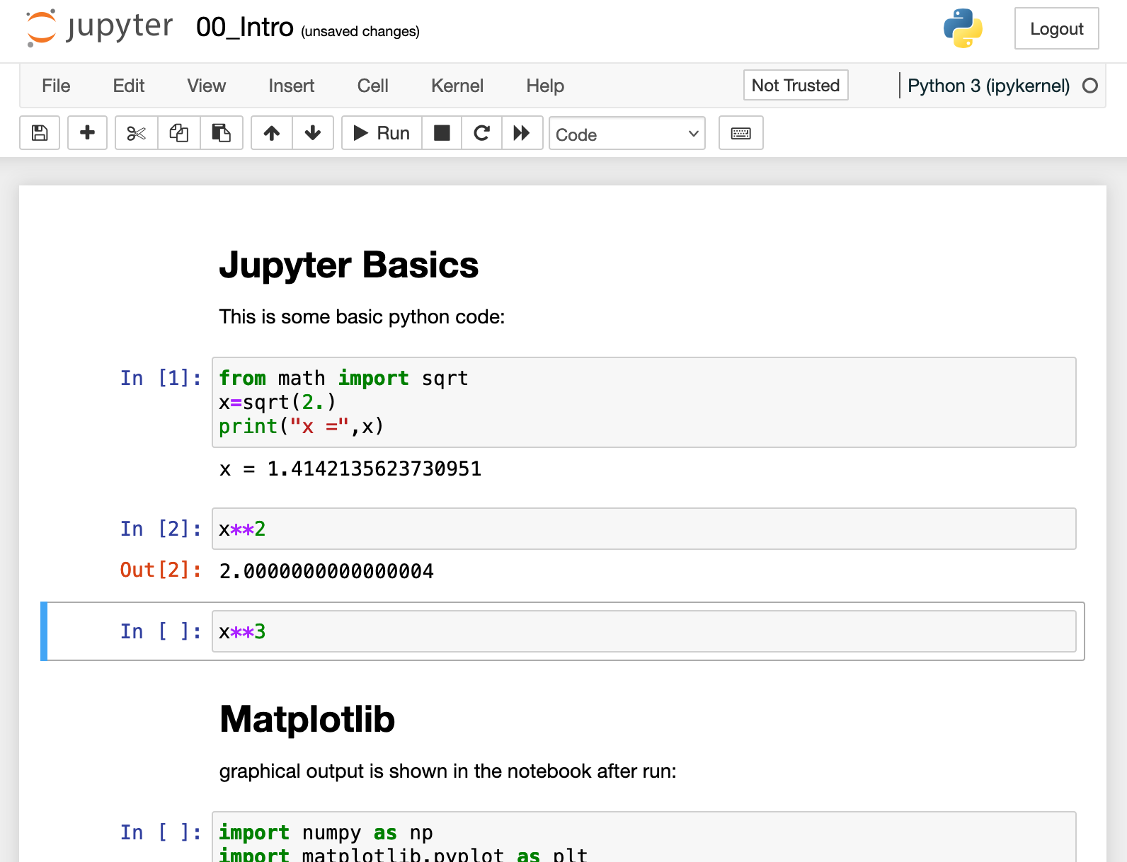
notebook page
Run python code
+ render cells
→ active cell only
Stop Running
python code
Cell with
text
Cell with
python code
active cell with code

Slide 16
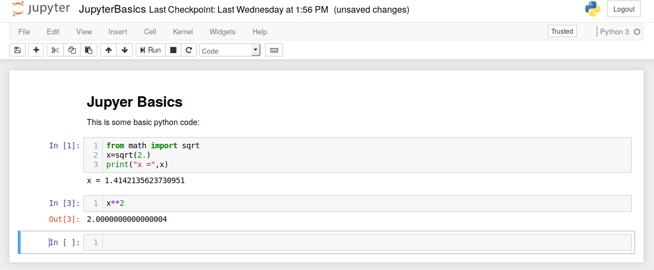
Cells after ‘run’
Change cell type
Code or
text (‘markdown’)
Cell code cell
added
All cells treated as
single python code

Slide 17
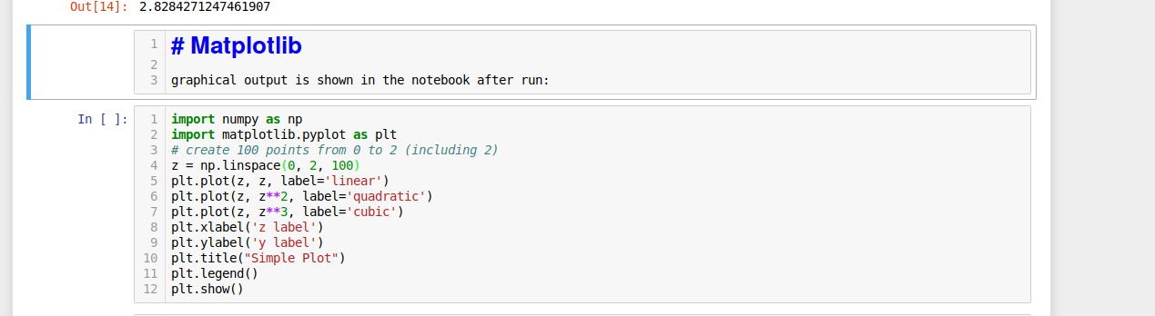
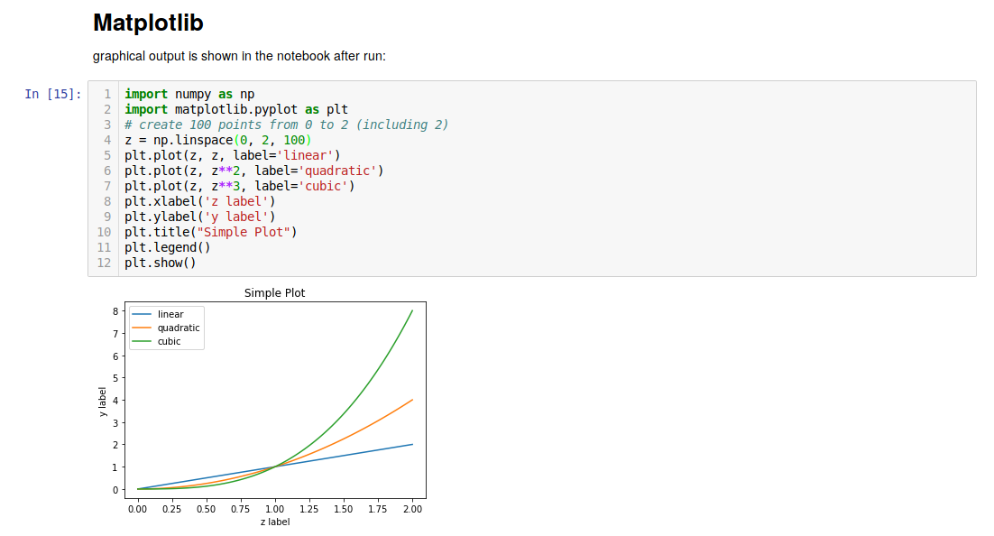
Matplotlib output is integrated

Slide 18
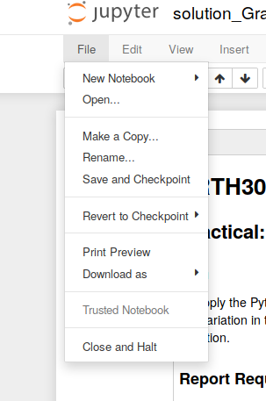
File Menu
Save your work
Return to last version
Create PDF file

Slide 19
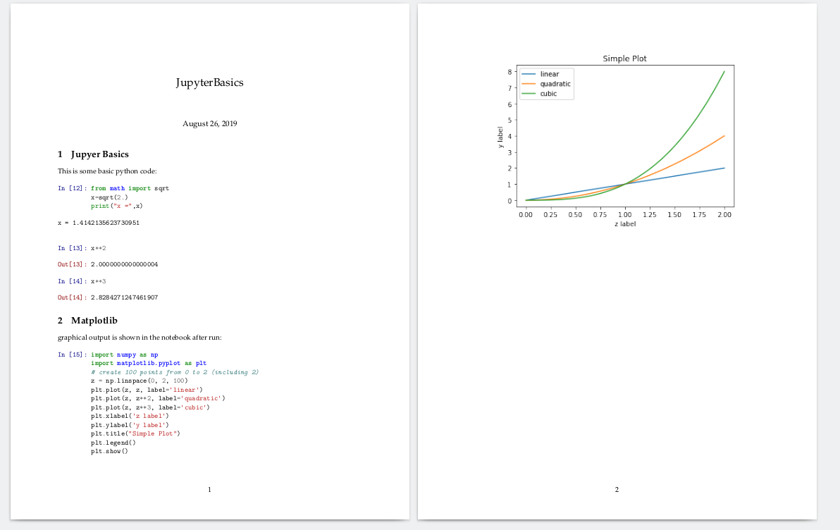
Example report

Slide 20
And more
‘Edit’ → copy & past & split & merge
‘Insert’ → add new cell
‘Run’ → run all cells, run cells above/below, …
For markdown text see for instance:
  https://www.datacamp.com/community/tutorials/markdown-in-jupyter-notebook

